Slide 1
CSCI561 Fall 2018 Week 13 Discussion
Prof Sheila Tejada
Prof Wei-min shen
Prof Ning wang
cs561-l@mymaillists.usc.edu
Instructor: Prof Tejada

Slide 2
Probability
Your doctor performs a series of medical tests. You test positive for a serious, but very rare disease. The test is 99% accurate, meaning the probability that it is positive when you do have the disease is 0.99, and the probability that it is negative if you don’t is also 0.99. The disease strikes 1 in 10,000.
What is the probability that you have the disease? Give both the formula and the value.
P(test|disease) = 0.99 P(¬test|¬disease) = 0.99
P(disease) = 0.0001
What the patient is concerned about is P(disease|test).
P(disease|test)
= P(test|disease)P(disease) = 0.99×0.0001 = .000099
P(test|disease)P(disease)+P(test|¬disease)P(¬disease) = 0.99×0.0001+0.01×0.9999 =.010098
= .000099 / .010098 = .009804
Notes:
Roughly speaking, the reason it is a good thing that the disease is rare is that P(disease|test) is proportional to P(disease), so a lower prior for disease will mean a lower value for P(disease|test). Roughly speaking, if 10,000 people take the test, we expect 1 to actually have the disease, and most likely test positive, while the rest do not have the disease, but 1% of them (about 100 people) will test positive anyway, so P(disease|test) will be about 1 in 100. More precisely, using the normalization equation from page 480:

Slide 3
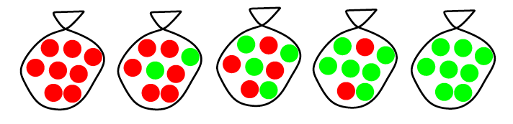

Candy Example
P(d_{j}|h_{i}) when d_{j} is a Lime
Suppose there are fives kinds of candy bags:
Then we observe candies:
What kind of bag is it? What flavor will be next?
Assume big bag so that draws are i.i.d. P(d | h_{i}) = π_{j} P(d_{j} | h_{i})
P(d | h_{i}) = P(lime | h₃) P(lime | h₃) P(lime | h₃) P(lime | h₃) P(lime | h₃) P(lime | h₃) P(lime | h₃) P(lime | h₃) P(lime | h₃) P(lime | h₃) = .5 * .5 * .5 * .5 * .5 * .5 * .5 * .5 *.5 *.5
Hypothesis | Prior | Cherry | Lime
h₁ | .1 | 100% | 0%
h₂ | .2 | 75% | 25%
h₃ | .4 | 50% | 50%
h₄ | .2 | 25% | 75%
h₅ | .1 | 0% | 100%
P(d_{j}|h₁)
P(d_{j}|h₂)
P(d_{j}|h₃)
P(d_{j}|h₄)
P(d_{j}|h₅)

Slide 4
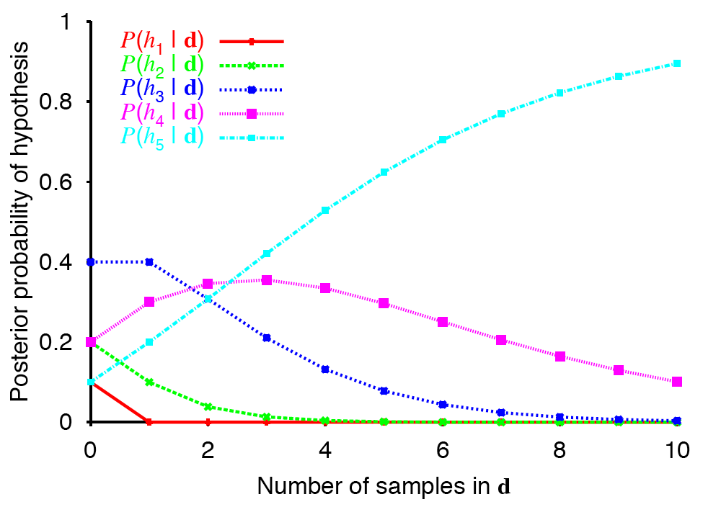
Posterior Probability of H
(all lime)
Computed as P(h_{i} | d) = απ_{j} P(d_{j} | h_{i}) P(h_{i})
Ex: P(h₃| d) = απ_{j} (.5 * .4)
Notes:
Predicted probabilities over different kinds of bags
Start at 0 with prior probabilities but shift over time based on what seen.

Slide 5
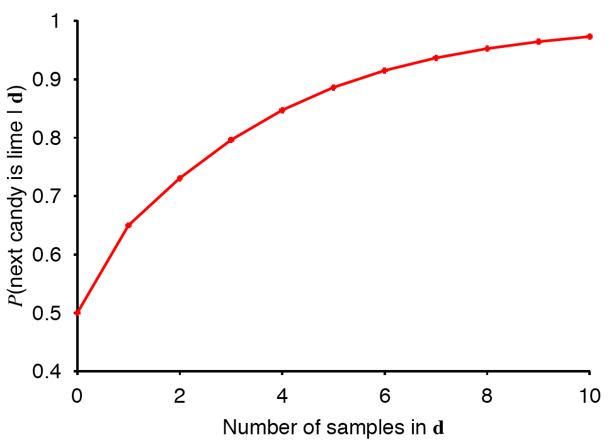
Probability of Predicting Lime
(all lime)
Computed as P(lime | d) = Σ_{i} P(lime | h_{i})P(h_{i} | d)

Slide 6
Naïve Bayes Classifier

Slide 7
Naïve Bayes

Slide 14
MDP
Ut+1(s) = + MaxaεA { R(s) + γΣs’εS P(s’|a,s) Ut(s’)}
U1( S1) = Max ( (8 + 0.5*(0.5*0+0.5*0) ) , (16 + 0.5*1*0) ) = Max (8,16) = 16
U1(S2) = Max ( (-4 + 0.5*1*0 ) , (-4 + 0.5*1*0) ) = Max (-4,-4) = -4
U2(S1) = Max ( (8 + 0.5*(0.5*16+0.5*-4) ) , (16 + 0.5*1*-4) ) = Max (11,14) = 14
U2(S2) = Max ( (-4 + 0.5*1*-4 ) , (-4 + 0.5*1*-4) ) = Max (-6,-6) = -6
Notes:
Ut+1(s) = + MaxaεA { R(s) + γΣs’εS P(s’|a,s) Ut(s’)}
U1( S1) = Max ( (8 + 0.5*(0.5*0+0.5*0) ) , (16 + 0.5*1*0) ) = Max (8,16) = 16
U1(S2) = Max ( (-4 + 0.5*1*0 ) , (-4 + 0.5*1*0) ) = Max (-4,-4) = -4
U2(S1) = Max ( (8 + 0.5*(0.5*16+0.5*-4) ) , (16 + 0.5*1*-4) ) = Max (11,14) = 14
U2(S2) = Max ( (-4 + 0.5*1*-4 ) , (-4 + 0.5*1*-4) ) = Max (-6,-6) = -6

Slide 15
Decision Tree
At root: I(3/6 , 3/6 ) = 1 Remainder(A) = 3/6 I(2/3 ,1/3) + 3/6 I(2/3,1/3) Remainder(B) = 2/6 I(2/2 , 0 ) + 4/6 I ( 1⁄4 , 3⁄4 ) Remainder(C) = 3/6 I(2/3 , 1/3 ) + 1/6 I(1,0) + 2/6 I(1/2 , 1⁄2 ) IG(B) is the largest so it will be the root. Similarly, next one is A , and then C.
Notes:
At root: I(3/6 , 3/6 ) = 1 Remainder(A) = 3/6 I(2/3 ,1/3) + 3/6 I(2/3,1/3) Remainder(B) = 2/6 I(2/2 , 0 ) + 4/6 I ( 1⁄4 , 3⁄4 ) Remainder(C) = 3/6 I(2/3 , 1/3 ) + 1/6 I(1,0) + 2/6 I(1/2 , 1⁄2 ) IG(B) is the largest so it will be the root. Similarly, next one is A , and then C.

